Slide 1
Data Structures
Backtracking

Slide 2
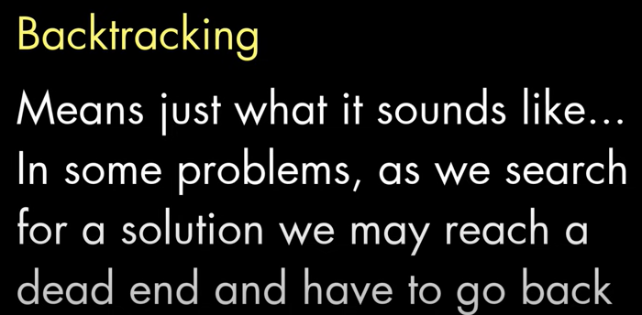

Slide 3
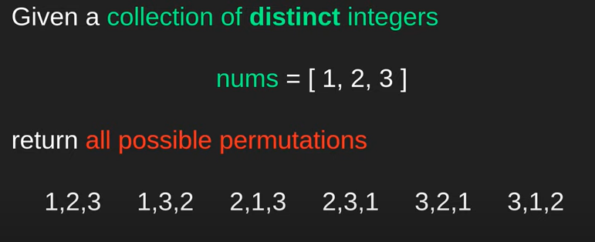

Slide 4
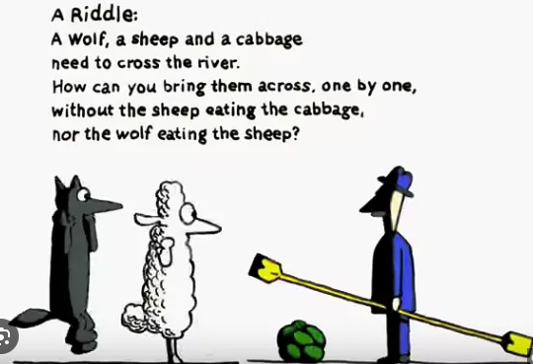
Crossing River - Lion, Sheep, Grass

Slide 5
Brute force Approach
Brute Force algorithms are straightforward methods of solving a problem that rely on sheer computing power and trying every possibility
Example: You forgot your password
Brute force solution: Generate all possible combinations and use the correct one to sign in!

Slide 6
Backtracking
Backtracking is like a refined brute force
At each step, we eliminate choices that are obviously not possible and proceed to recursively check only those that have potential

Slide 7
Backtracking
When solving problems with recursion, we divide it into sub-problems e.g. recursive calls in Fibonnaci, factorial
What if we don’t know what the correct sub-problem is?
Using Backtracking, we can explore sub-problems until we find the optimal one

Slide 8
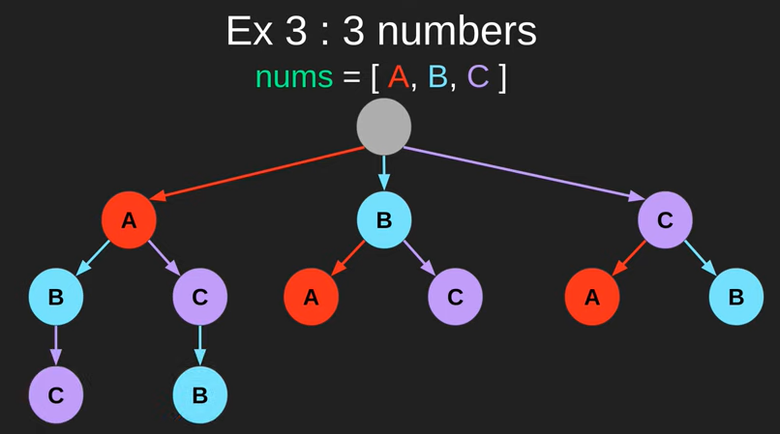
State-space tree

Slide 9
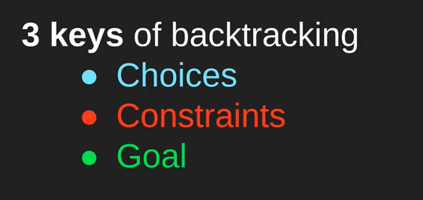

Slide 10
Example
Pseudo-code for finding factorial:
function factorial(x) if x is 0 // base case return 1 else return x * factorial(x-1) // break into smaller problem(s)

Slide 11
Example
What if we don’t know the recursive case for factorial i.e. x * factorial(x-1)
We can recursively try out different sub-solutions and backtrack if it does not lead us to the correct overall solution

Slide 12
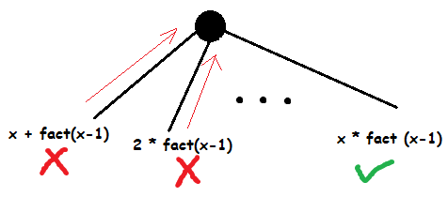
Example

Slide 13
Maze Runner

Slide 14
Example
N-Queens Problem: Given a grid having N×N cells, we need to place N queens in such a way that no queen is attacked by any other queen. A queen can attack horizontally, vertically and diagonally
We continue placing queens as long as:
The number of unattacked cells is not 0
The number of queens to be placed is not 0

Slide 15
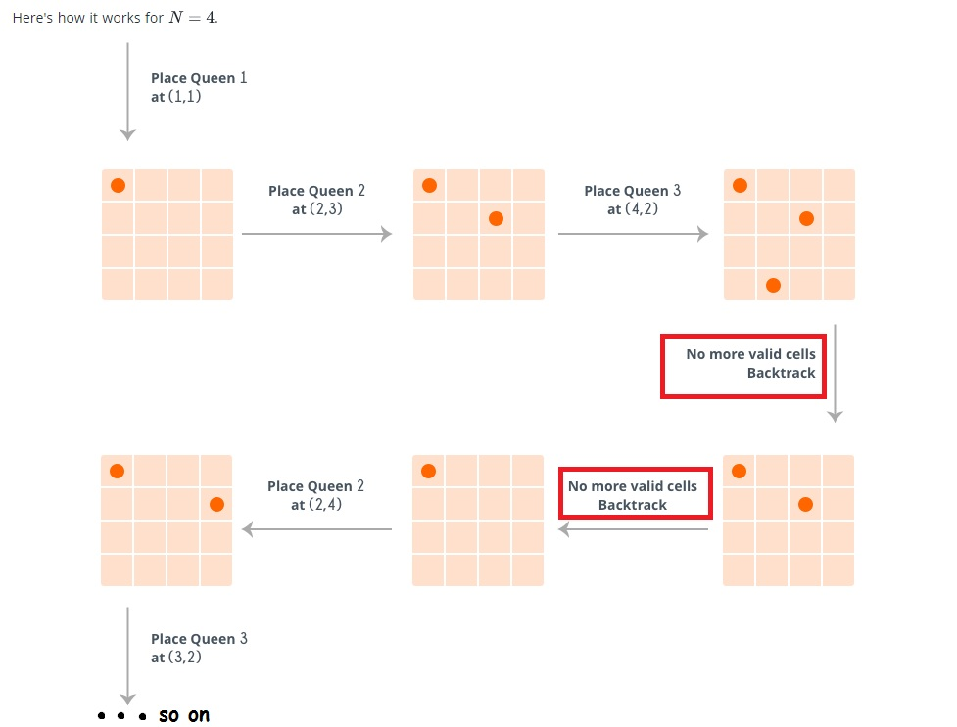
Example

Slide 16
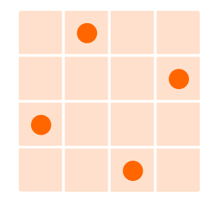
Example
Goal state:

Slide 17
Pruning
Eliminating choices that do not lead us to solution
Much of what we did in the previous examples

